Slide 1
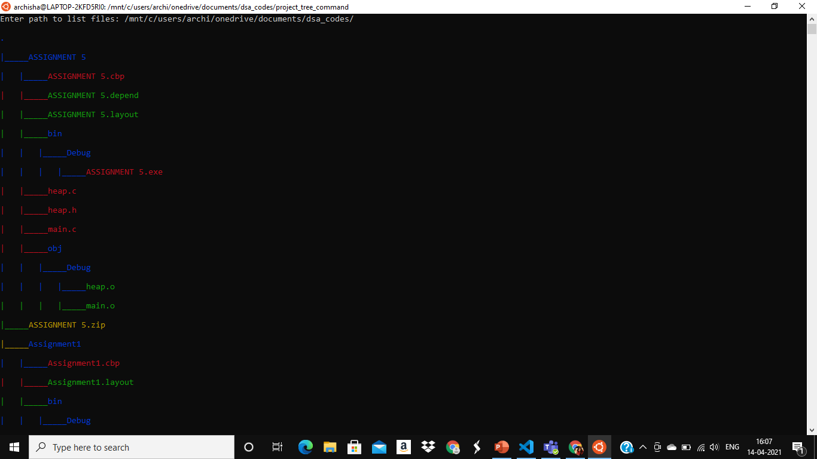
DSA MINI PROJECT
TREE COMMAND
BY ARCHISHA SHUKLA
MIS:111903140
DIV 2 S3 BATCH

Slide 2
TREE
1.Tree is a command line program used to display contents of a directory in a tree like format.
2.Available on UNIX,LINUX,WINDOWS

Slide 3
FLAGS IN MY TREE
-noIndentation : written on cmd this lists all the files and folders in the path specified by the user without any indentation
-i : written on cmd this lists all the files and folders in the path specified by the user with indentation
-u : written on cmd this lists all the user details
-help : written on cmd this lists all flags to help the user
-v : version of the tree
-c : written on cmd this lists all the files and folders in the path specified by the user with indentation and color according to the file type

Slide 4
FLAGS IN MY TREE
-mediaFiles : written on cmd this lists all the files and folders in the path specified by the user which are of media type for eg-jpeg,mp4 etc with indententation
-compressedFiles : written on cmd this lists all the files and folders in the path specified by the user which are of compressed type for eg-.zip,rar etc with indententation
-programFiles : written on cmd this lists all the files and folders in the path specified by the user which are of program type for eg-.c,.o,.js etc with indententation
-matchPattern : written on cmd this lists all the files and folders in the path specified by the user which have any portion of the name that matches specified pattern with indententation
-IPattern : written on cmd this lists all the files and folders in the path specified by the user which have any portion of the name that does not matche specified pattern with indententation
-d : List directories only in tree format.

Slide 5
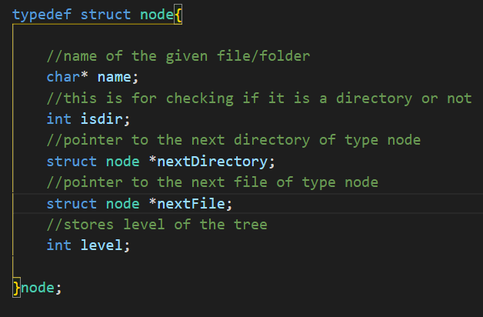
ADT

Slide 6
STRUCT DIRENT
struct dirent {
ino_t d_ino; /* inode number */
off_t d_off; /* offset to the next dirent */
unsigned short d_reclen; /* length of this record */
unsigned char d_type; //type of file; not supported by all file system types
char d_name[256]; /* filename */
};

Slide 7
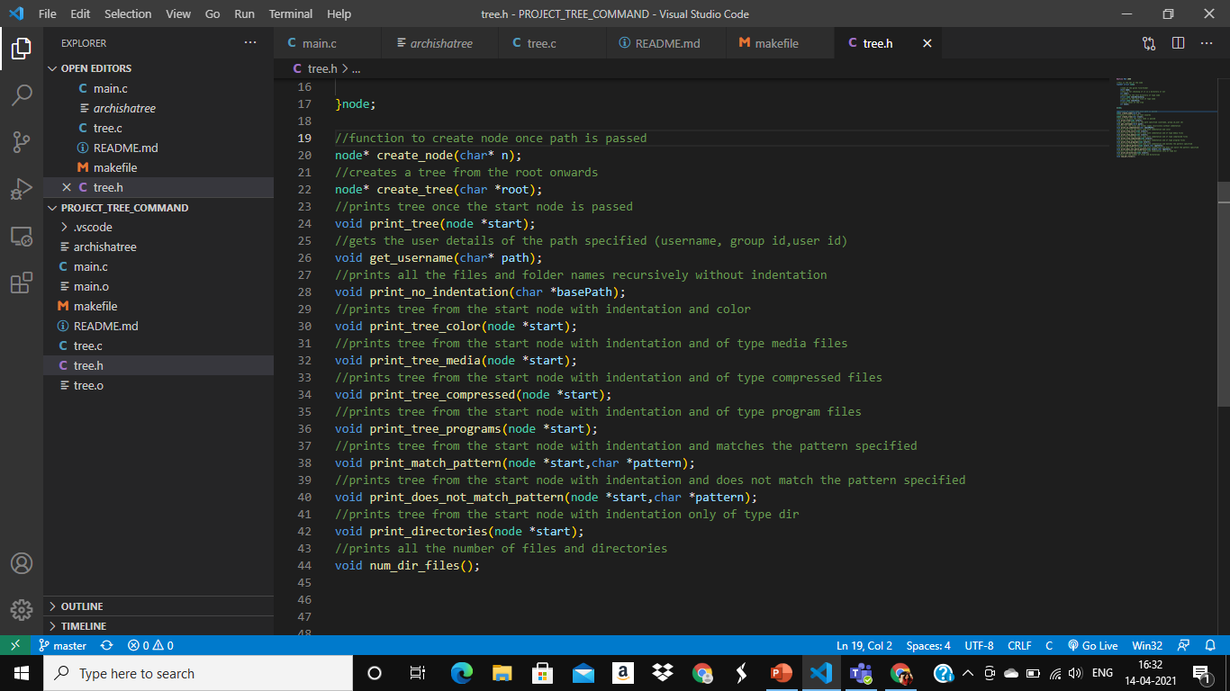
FUNCTIONS

Slide 8

FUNCTIONS

Slide 9
REFRENCES
https://man7.org/linux/man-pages/man2/lstat.2.html#:~:text=The%20stat%20structure%20All%20of,st_uid%3B%20%2F*%20User%20ID%20of
https://man7.org/linux/man-pages/man3/readdir.3.html
https://iq.opengenus.org/traversing-folders-in-c/
https://www.theurbanpenguin.com/4184-2/
https://www.tutorialspoint.com/c_standard_library/c_function_strstr.htm
https://pubs.opengroup.org/onlinepubs/7908799/xsh/dirent.h.html

Slide 10
THANK YOU

